Slide 1
H1B Visa Prediction
Decision support system in KNIME

Slide 2
H1B visa
non-immigrant visa that allows US companies to hire graduates in specialized fields (IT, finance, accounting, architecture, engineering, math, medicine, etc.)
because of the speed of application, it's more appealing to companies looking to hire non-U.S. workers than the green card
There are a large number of entries each year (> 2 million) and the number of places is limited
It became very important for employers to “know in advance” the chances for an individual candidate, ie whether to submit an application at all, which is why numerous research papers on this topic were written:
O. C. M. Beliz Gunel, “Predicting the Outcome of H-1B Visa Applications.
D. A. Pandya, “Predicting filed H1-B Visa Petitions’ Status”
N. N. Madhana Sohan Kumar, “A Predictive Model for H1-B Visa Petition Approval,”

Slide 3

Problem - a large number of rejected applications
65 000
Limit
> 2 million applications
Possibility to obtain a permanent visa

Slide 4
Decision Support System Users
Strategic decisions (job advert for a specific position for foreign nationals)
HIGHER MANAGEMENT
The decision to apply for an H1B visa on behalf of the applicant
MIDDLE MANAGEMENT

Slide 5
Dataset
https://public.enigma.com/browse/d582dfbd-4329-4b5e-b0c9-39149f5dd546
Dataset has the following information on individual candidates (2011-2018):
Position
The amount of salary
City / State
Part / full time
Etc.
The target variable and the one that will try to predict it is the case status variable and it contains two possible values (certified or denied).

Slide 6
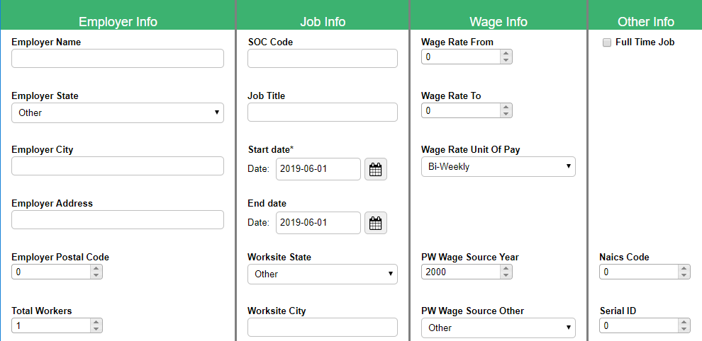
Solution Proposal - Input

Slide 7
Solution Proposal - Exit
Prediction 1 - Random Forest | Prediction 2 - Naive Bayes
CERTIFIED | DENIED
The output of the first prediction method
The output of the second prediction method

Slide 8
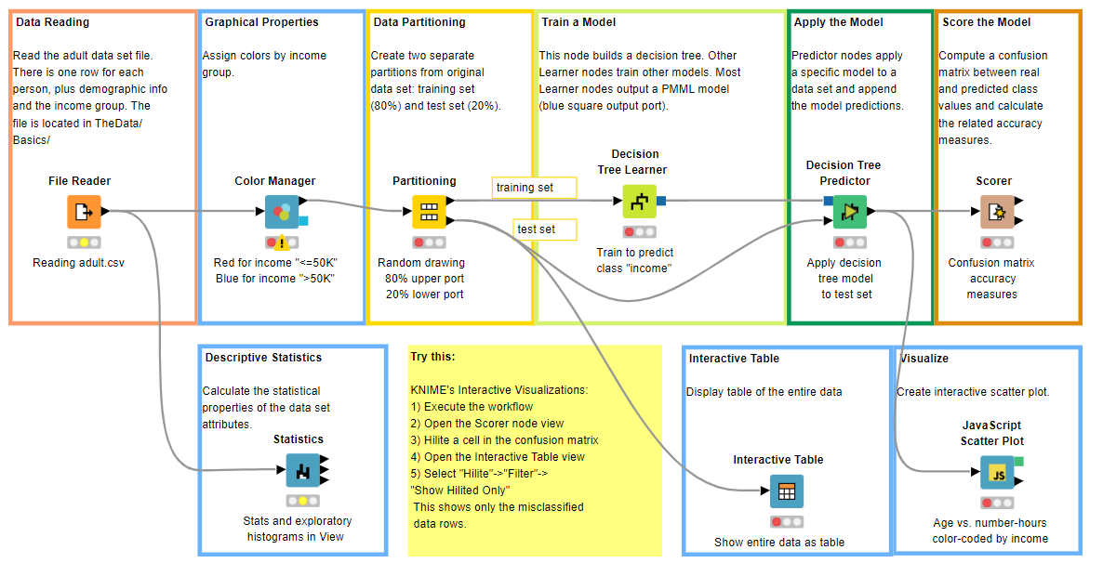
Similar solution in KNIME- adult income

Slide 9
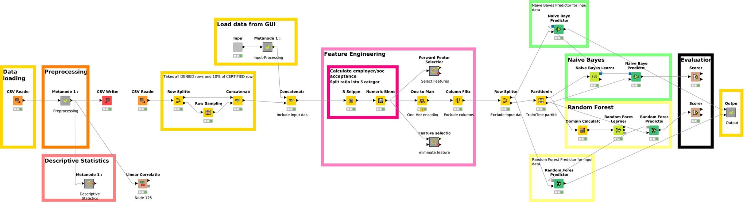
System components - KNIME
The system consists of the following components: Data set loading, preprocessing, feature engineering, partitioning, application of prediction methods, model evaluation.

Slide 10
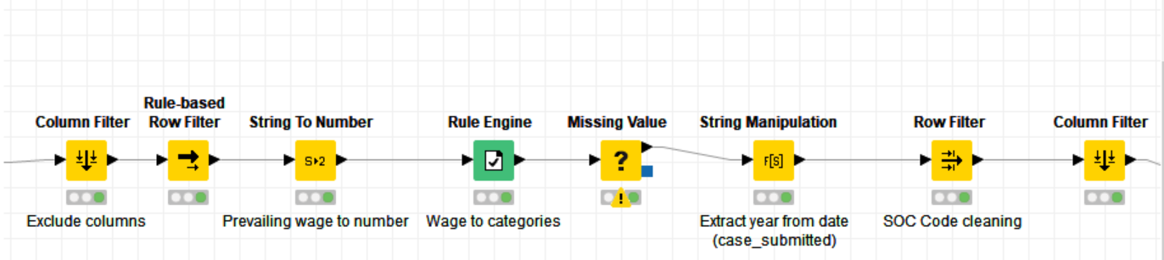
Preprocessing

Slide 11
Prediction methods
Naive Bayes
Naive Bayes was selected for the fact that it performs well in the case of large amounts of data, and for advantages such as training speed and prediction.
Random Forest
In our case, the dataset had highly unbalanced data (0.875: 0.125, certified: denied). The Random Forest algorithm is cited in the literature as a classifier that performs better than others when it comes to the problem of unbalanced datasets, and in terms of ease of implementation and performance.

Slide 12
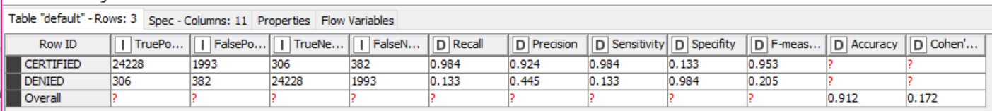
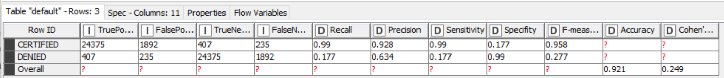
Evaluation
Naive Bayes Accuracy statistics
Random Forest Accuracy statistics

Slide 13
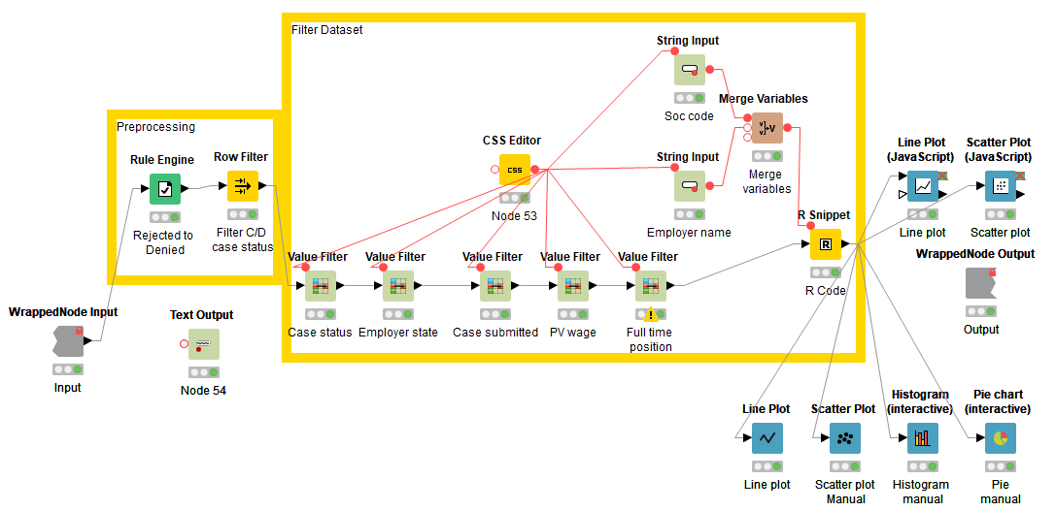
Descriptive statistics
Detaljna slika implementacije

Slide 14
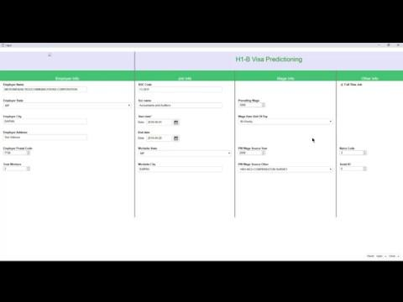
GUI Video

